Slide 1
NFA and Kleene’s Theorem
Shakir Ullah Shah
a
Notes:
<number>
aa

Slide 2

Proof 2 of Rule 1, Part 3, Theorem 6
Rule 1 states that there are FAs for the languages {a}, {b}, and {Λ}.
Proof:
Step 1: The above three languages can all be accepted respectively by the NFAs below:
Step 2: By Theorem 7, for every NFA, there is an equivalent FA. Hence, there must be FAs for these three languages as well.
a

Slide 3
NFA corresponding to Union of FAs
a
Notes:
<number>

Slide 4
NFA corresponding to Union of FAs
Method:
Introduce a new start state and connect it with the states originally connected with the old start state with the same transitions as the old start state, then remove the –ve sign of old start state. This creates non-determinism and hence results in an NFA.
a
Notes:
<number>

Slide 5
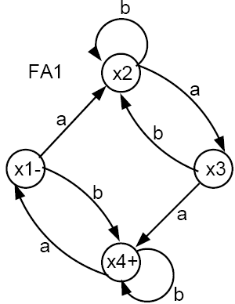
Example
Consider the FA₁ and FA₂ below:
a

Slide 6
Example
Using the above algorithm (Step 1) we produce the following NFA.
Notes:
aa
<number>

Slide 7
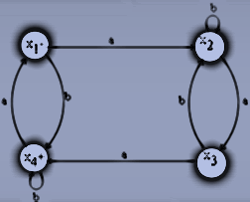

Example
FA1
FA2
Notes:
<number>

Slide 8
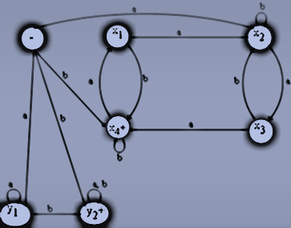
NFA equivalent to FA₁ U FA₂
Notes:
<number>

Slide 9
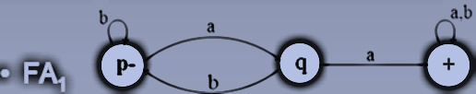
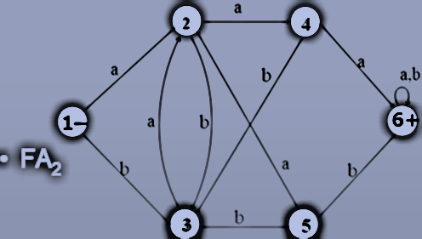
Example
Notes:
<number>

Slide 10
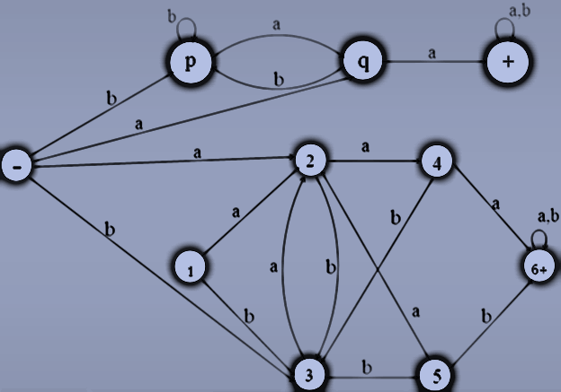
NFA equivalent to FA₁ U FA₂
Notes:
<number>

Slide 11
NFA corresponding to Concatenation of FAs
Notes:
<number>

Slide 12
NFA corresponding to Concatenation of FAs
Method:
Introduce additional transitions for each letter connecting each final state of the first FA with the states of second FA that are connected with the initial state of second FA corresponding to each letter of the alphabet.
Remove the +ve sign of each of final states of first FA and –ve sign of the initial state of second FA. It will create non-determinism at final states of first FA and hence NFA, thus obtained, will be the required NFA.
Notes:
<number>

Slide 13
NFA corresponding to Concatenation of FAs
Note:
If first FA accepts the Null string then every string accepted by second FA must be accepted by the concatenation of FAs as well. This situation will automatically be accommodated using the method discussed earlier.
However if the second FA accepts Null string, then every string accepted by first FA must be accepted by the required FA as well. This target can be achieved as, while introducing new transitions at final states of first FA, the +ve sign of these states will not be removed.
Notes:
<number>

Slide 14
Note Continued …
Lastly if both FAs accepts the Null string, then the Null string must be accepted by the required FA. This situation will automatically be accommodated as the second FA accepts the Null string and hence the +ve signs of final states of first FA will not be removed.
Notes:
<number>

Slide 15
Example (No FA accepts Null string)
Notes:
<number>

Slide 16
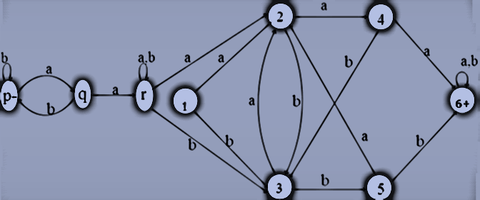
NFA equivalent to FA₁FA₂
Notes:
<number>

Slide 17
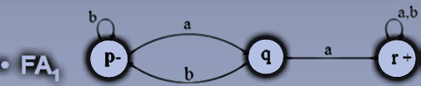
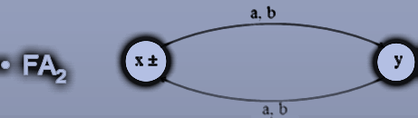
Example (FA₂ accepts Null string)
Notes:
<number>

Slide 18
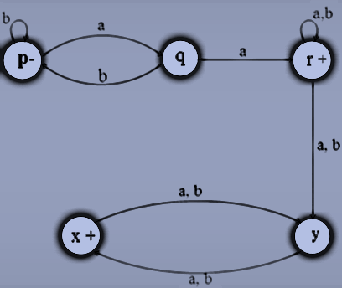
NFA equivalent to FA₁FA₂
Notes:
<number>

Slide 19
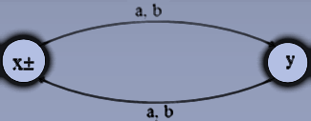
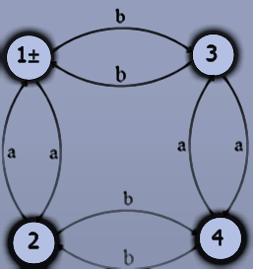
Example (Both FAs accept Null string)
FA₁
FA₂
Notes:
<number>

Slide 20
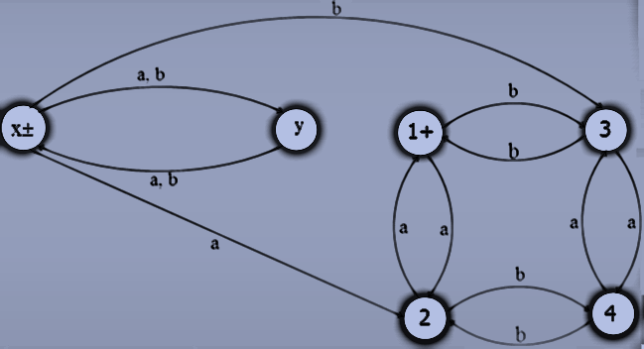
NFA equivalent to FA₁FA₂
Notes:
<number>

Slide 21
NFA corresponding to the Closure of an FA
Notes:
<number>

Slide 22
NFA corresponding to the Closure of an FA
Apparently, it seems that since closure of an FA accepts the Null string, so the required NFA may be obtained considering the initial state of given FA to be final as well, but this may allow the unwanted string to be accepted as well. For example, an FA, with two states, accepting the language of strings, defined over. Σ={a, b}, ending in a, will accept all unwanted strings, if the initial state is supposed to be final as well.
Notes:
<number>

Slide 23
NFA for the Closure of an FA Continued …
Method:
Thus, to accommodate this situation, introduce an initial state which should be final as well (so that the Null string is accepted) and connect it with the states originally connected with the old start state with the same transitions as the old start state, then remove the –ve sign of old start state.
Introduce new transitions, for each letter, at each of the final states (including new final state) with those connected with the old start state. This creates non-determinism and hence results in the required NFA.
Notes:
<number>

Slide 24
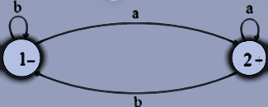
Example
Consider the following FA
It may be observed that the FA* accepts only the additional string which is the Null string
Notes:
<number>

Slide 25
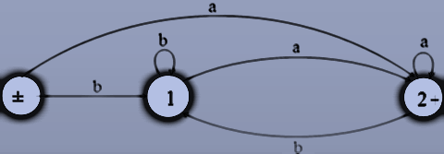
Example Continued …
As observed in the previous example the required NFA can be constructed only if the new initial state is introduced as shown below.
Notes:
<number>

Slide 26
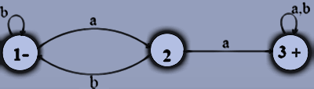
Example
Consider the following FA
It may be observed that the FA* accepts only the additional string which is the Null string.
Notes:
<number>

Slide 27
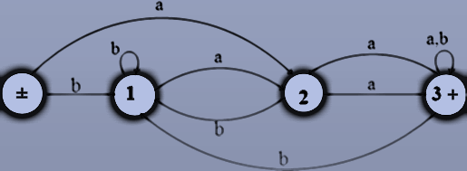
Example Continued …
Considering the state 1 to be final as well, will allow the unwanted strings be accepted as well. Hence the required NFA is constructed introducing the new initial state, shown below.
Notes:
<number>

Slide 28

Example
Consider the following FA
It can be observed that FA* not only accepts the Null string but every other string as well.
Notes:
<number>

Slide 29

Example continued …
Here we don’t need separate initial and final state. Hence an NFA corresponding to FA* may be
Notes:
<number>

Slide 30
NFA closure under union
Given two NFAs, say N/ and N, we would like to build an NFA for the language (N/) L (N).
The idea is to create a new initial state qs and connect it with a ε -transition to the two initial states of N/and N. Visually, the resulting NFA M looks as follows.

Slide 31
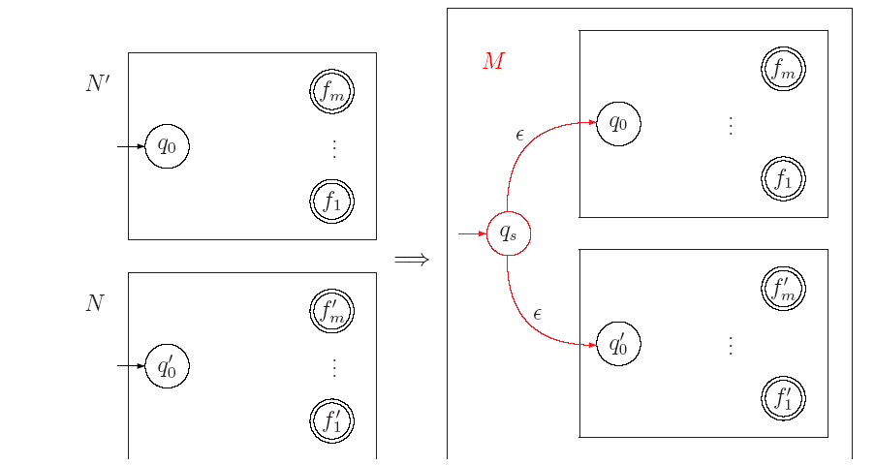
NFA closure under union

Slide 32
NFA closure under concatenation
Add Λ-transitions from all final states of first one NFA to the start state of second NFA.
Then declare the start state (of the new automata) to be the start state of first one NFA.
The final states (of the new automata) to be the final states of second one NFA.

Slide 33
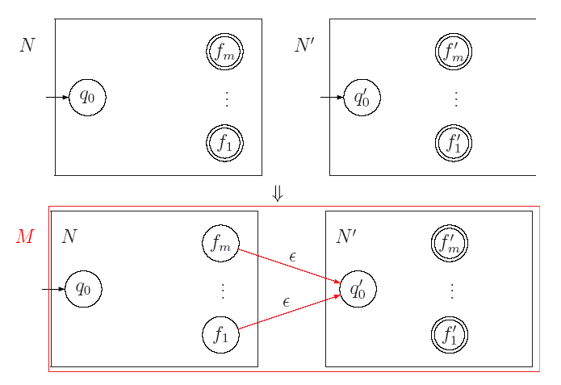

Slide 34
NFA closure under star
ε
o
ε
B
B
ε
ε
a

Slide 35
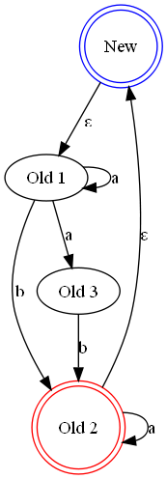
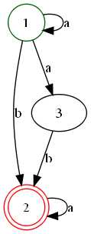
Example
Add a new state.
Make it the start state in the new NFA, and an accepting state.
Add an ε-arc from this state to the old start state.
Add ε-arcs from every final state to this new state

